Slide 1

NBA Draft Day Comparisons
By: Aydin Baradaran-Seyed,
Data Scientist

Slide 2
Quick Introduction to the NBA
NBA: National Basketball Association
30 teams: 29 in the USA, 1 in Canada
2 conferences: East and West
Playoffs: top 8 teams from each conference
Lottery: bottom 7 teams from each conference
The worse the record the higher the probability of obtaining the 1st overall pick
“Top prospects looked at being cornerstones, later picks looked at adding to a contending core”

Slide 3
NBA Draft
Every year, 60 athletes drafted
Mix of NCAA (college) Basketball and European League players.
Bleacher Report, NBA Real Draft etc. give comparisons
Usually done by the “eye” test
Advanced statistical reports due exist to prove

Slide 4
Reasoning Behind the Project
NBA draft make or break franchises every decade they exist (ex. 2019 Toronto Raptors Roster had no lottery picks).
Smaller market franchises use the draft to gain talent (OKC have 35+ draft picks spread across the next 7 years)
NBA rookie cards have become popular: Luka Doncic RC for 4.5 million, Giannis for 1.8,
Investing in the right rookie cards for any collector/fan can be lucrative.
NBA Top Shots an NFT platform is the future of “bit” money.
Next NBA TV deal is worth 75 billion.
The wrong pick can cost you millions to billions

Slide 5
The Project
Take NCAA statistics and create cluster groups.
1
Make predictions.
2
Use NBA stats to validate
3
Create NBA clusters
4
Compare with other sources

Slide 6
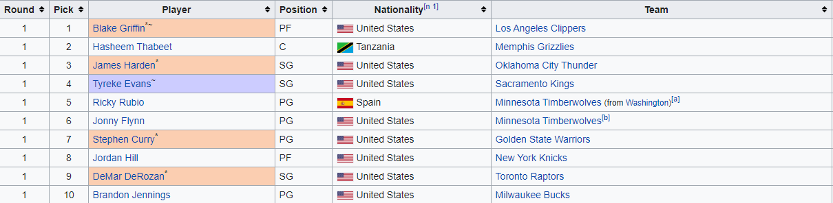
Scenario: Minnesota Timberwolves 2009
What's wrong with this picture?

Slide 7
Bleacher Report and NBADraft.net
BR Draft Net
Blake Griffin Carlos Boozer Karl Malone*
Hasheem Thabeet Samuel Dalembert Dikembe Mutombo*
James Harden Brandon Roy Manu Ginobili
Tyreke Evans Kendall Gill Jamal Crawford
Ricky Rubio Jason Williams Jose Calderon
Jonny Flynn Tony Delk Damon Stoudamire
Stephen Curry Chauncey Billups Mahmoud Abdul-Rauf
Jordan Hill Joe Smith Chris Bosh
DeMar DeRozan Jason Richardson Vince Carter
Brandon Jennings Terrell Brandon Kenny Anderson
Terrence Williams Josh Howard Isaiah Rider
Gerald Henderson John Salmons Latrell Sprewell
Tyler Hansbrough Tyrone Hill Eduardo Najera
Earl Clark Vladimir Radmanovic Marvin Williams

Slide 8
Model’s Comparisons
Blake Griffin -> Chris Webber
Hasheem Thabeet -> Ron Moore
James Harden -> Dwyane Wade
Tyreke Evans -> Lamar Odom
Jonny Flynn -> D.J. Augustin
Stephen Curry -> Richard Hamilton
Jordan Hill -> Sam Bowie
DeMar DeRozan -> Luol Deng
Terrence Williams -> Sam Young
Gerald Henderson -> Norm Nixon
Tyler Hansbrough -> Shelden Williams
Earl Clark –> Steve Downing

Slide 9
Results
Stephen Curry, Hasheem Thabeet, James Harden, Terrence Williams, Earl Clark 1st
2nd Blake Griffin, Jonny Flynn, Jordan Hill, DeMar DeRozan
Tyreke Evans, Gerald Henderson, Tyler Hansbrough.
Gerald Henderson prediction is the worst one.
Other two are very close to the others.
My Models Average: 539
BR Average: 595
Draft Net Average: 928

Slide 10
NBA DRAFT DAY COMPARISON
Through ML:
Modeled media outlets predictions
Scored based on accuracy of correct “predicts” (more to come)
Create groupings separating different tiers of players
NCAA stats compared and then looked at.
Predictions based on close matches

Slide 11
NBA Clustering
4 clusters were optimal
Each cluster had different tiers of players.
Cluster 2 were full of multiple time all stars and hall of famers
Cluster 3 had up and coming stars and above average role players
Cluster 1 were comprised of those who didn’t play as much (bench warmers)
Cluster 0 were those who did get an opportunity

Slide 12
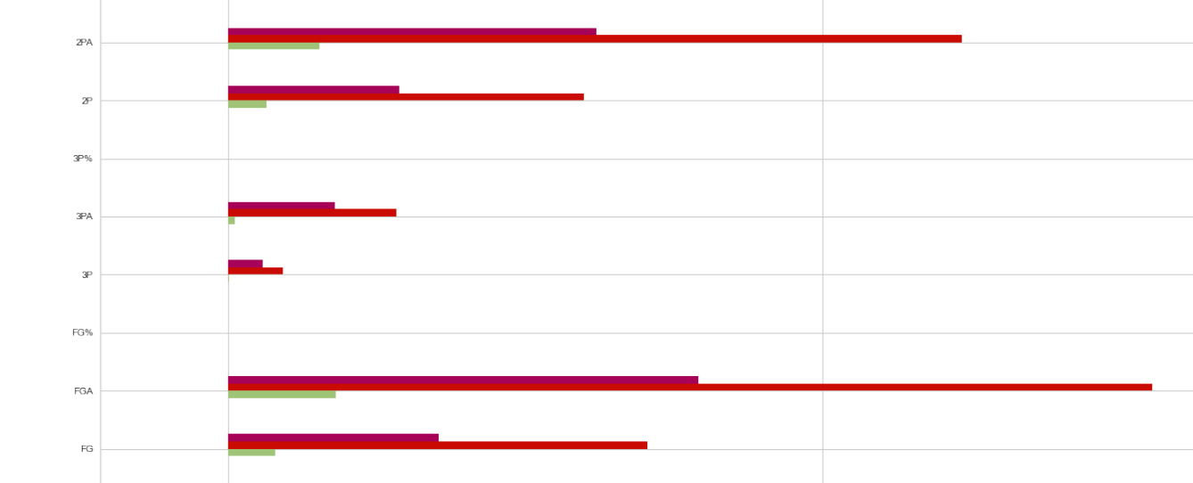
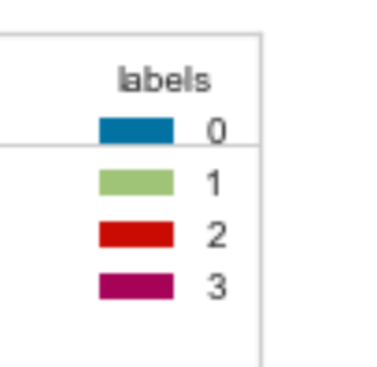

Slide 13
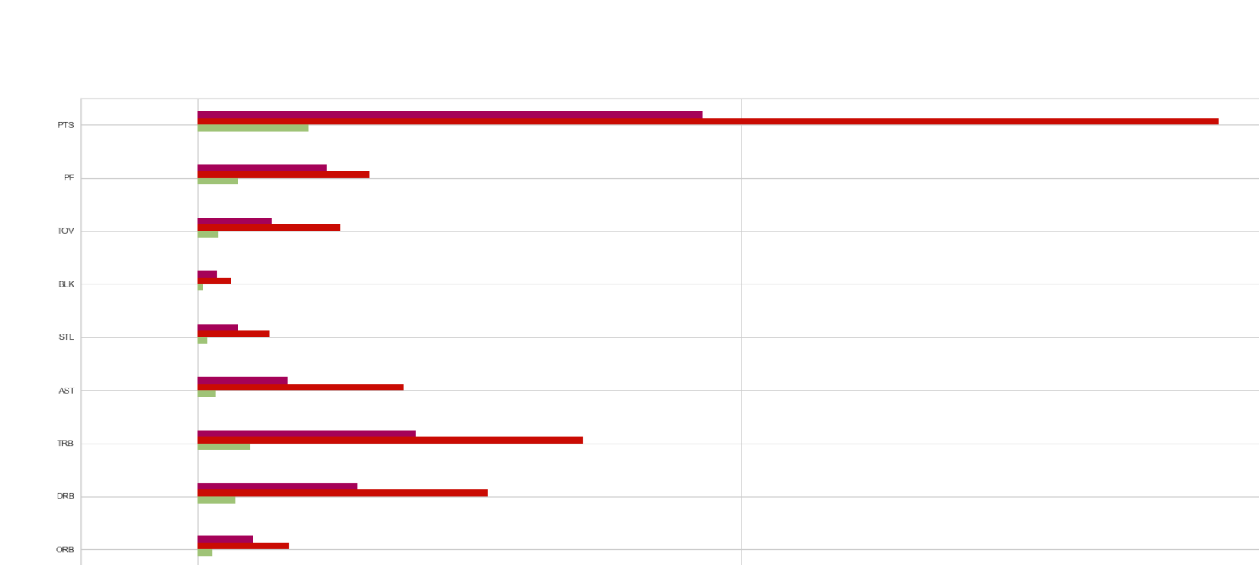

Slide 14
College Clusters
Cluster 0 -> clear cut above prospect heading into the draft (top 10)
Cluster 1 -> more than 1 year in the NCAA, (late) lottery projected
Cluster 2 -> Long term prospects to develop in the NBA
Cluster 3 -> Similar to cluster 1 but a tier below

Slide 15
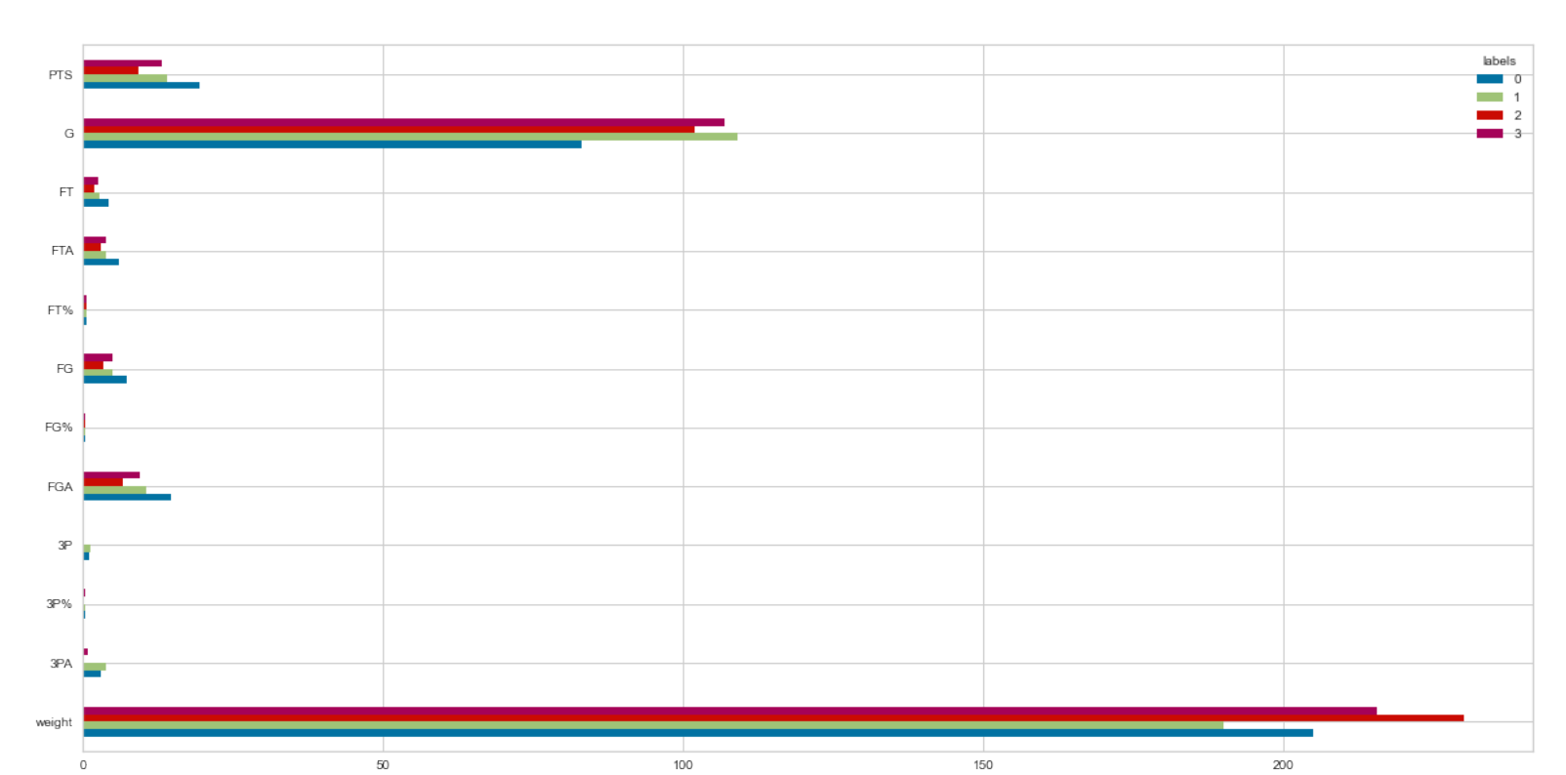

Slide 16
Concluding Remarks
Bleacher Report: ~41% accuracy
Actual NBA Draft Net ~35% Accuracy

Slide 17
Future Draft Predictions for 2020-2021
Cade Cunningham -> Eddie Griffin/Blake Griffin
Evan Mobley -> Maurice Harkless
Jalen Suggs -> Jayson Tatum
Scottie Barnes -> Nerlens Noel
Moses Moody -> Jayson Tatum
Keon Johnson -> John Starks
Corey Kispert -> Dorian Finney-Smith
Kai Jones -> Charles Pittman
Franz Wagner -> Antonio McDyess
Ziaire Williams -> Tariq Abdul-Wahad
James Bouknight -> Derrick Rose

Slide 18
Rookie Predictions
Player Name | PTS | G | MP | FGA | FG | 3PA | 2PA | FT | FTA | AST | TRB
Cade Cunningham | 22.5 | 82 | 38 | 17 | 8.5 | 1 | 16 | 5 | 9 | 4 | 8
Evan Mobley | 9 | 76 | 26 | 8 | 4 | 2 | 6 | 1 | 2 | 2 | 6
Jalen Suggs | 14 | 80 | 31 | 11 | 5 | 3 | 8 | 3 | 4 | 2 | 5
Scottie Barnes | 10 | 75 | 31 | 9 | 4 | 0 | 9 | 2 | 3 | 2 | 8
Moses Moody | 14 | 80 | 31 | 11 | 5 | 3 | 8 | 3 | 4 | 2 | 5
Keon Johnson | 8 | 61 | 20 | 7 | 3 | 2 | 5 | 2 | 2 | 4 | 2
Corey Kispert | 5 | 81 | 21 | 4 | 2 | 2 | 2 | 1 | 1 | 1 | 3
Kai Jones | 3 | 28-82 | 6-25 | 2 | 1 | 0 | 2 | 1 | 1 | 1 | 1
Franz Wagner | 14 | 75 | 30 | 12 | 6 | 0 | 12 | 2 | 3 | 1 | 8
Ziaire Williams | 7 | 59 | 17 | 6 | 3 | 0-1 | 6 | 1-2 | 2 | 1 | 2
James Bouknight | 17 | 81 | 37 | 15 | 7 | 1 | 14 | 3 | 3 | 6 | 4

Slide 19
Looking Forward
Improve model accuracy for predictions
Improve distance score
Have an NBA analyst look at it
Marketing
Create a dashboard
  Redraft
  Sabermetrics created

Slide 20
Thank you for your time, Questions?
LinkedIn: https://www.linkedin.com/in/aydin-baradaran-seyed/
GitHub: https://github.com/AydinBaradaran

